Slide 1
Bolted System: Auto-deployment Cloud Project
(Sprint 3)
Vidya Anandamurali
Pei Jia
Yuxi Jiang
Jiangnan Zou

Slide 2
Project Description (Recap)
Automate the deployment of Bolted which consists of:
Installation and configuration of each component of the Bolted system (HIL, BMI, Keylime and orchestration)
Integrating all the components together
Bolted system should be able to be installed on any cloud platform
Notes:
-we are making the Bolted system, not any single component but integrate the whole thing together. But installation of Bolted is very complicated and time costy.
-we are developing a program that allows the user, who is the cloud provider of the cloud platform, to install and configure the Bolted system in their cloud platform easily.
-They can use one step or few step without dive into installation process of each component itself to install the Bolted system on their platform. -That is why it is called automatic. Once the user finish the installation, the bolted system should be able to allow cloud provider deploy nodes to tenant.

Slide 3
Use Case
As a cloud provider, I want to deploy Bolted System on my cloud platform easily without having to call upon a personnel to configure the components.
Minimum Viable Product
To deliver a system that doesn’t require separate installation and configuration procedure for each component of the bolted system
Develop an ansible playbook for each component first and then an overall playbook for all four components to work together.
Notes:
Let’s give a simple example of user case, this is the only user case that we have. As a cloud provider, I want to install bolted system on my cloud platform without understand how each component is set up in my system. namely, I want the installation automated and easy.

Slide 4
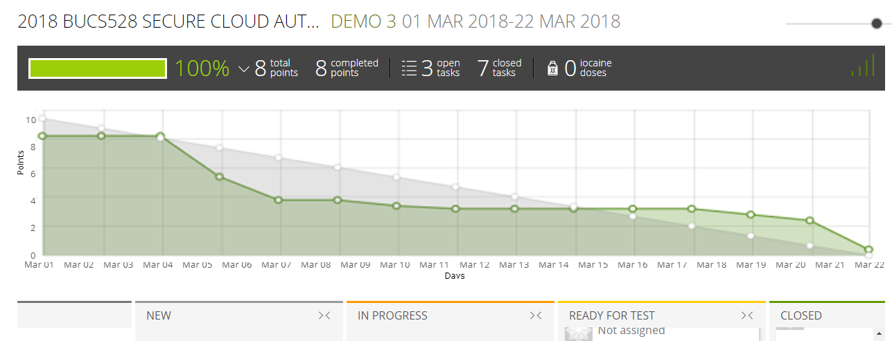
Burndown Chart

Slide 5
Last Sprint Report
Finished automated installation process of each component and started configuring communication between each component on local machine. √
Wrote Bash script for automated installation of each component. √
Tested installation result on local virtual machine and Kaizen OpenStack virtual machine. √
Tested Bash/Ansible script on server. √
Created a Docker container and installed HIL, Keylime, BMI in container. √
Installed Python 2.7.10+ on local directory for installation. √

Slide 6

Project Progress of Docker
Learned how to use Docker by learning tutorials
Learned how to orchestrate services by learning Swarm
Generated Dockerfile based on Bash script
Containerize HIL
Addressing user privilege problem
Containerize BMI
Addressing the same user privilege problem
Containerize Keylime
Successfully build image
Yet to configure running parameters

Slide 7
Project Progress of Kaizen
Learn Kaizen by going through the tutorials
Installed all the components on Kaizen using automated installation script
Set up local python environment on Kaizen

Slide 8
Project Progress of Automation
Automate Installation using Bash Script
Done for all three components - BMI, HIL and keylime

Slide 9
Demo

Slide 10
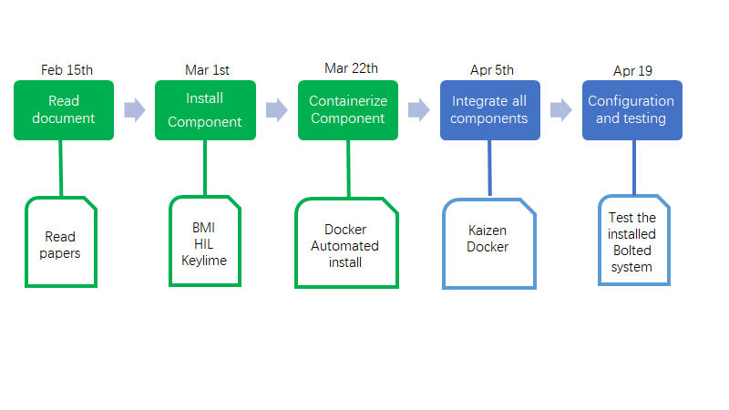
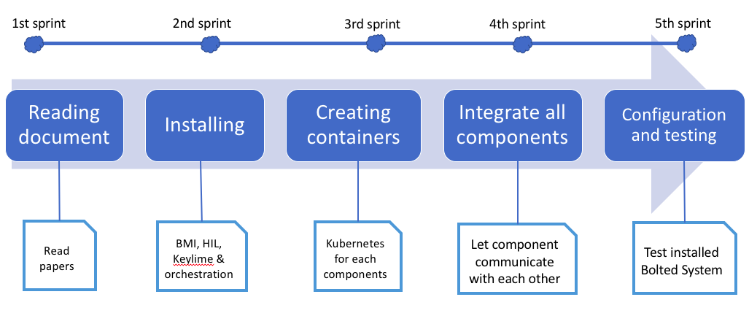
Project Plan

Slide 11
Responsibilities for next sprint
Set communication between the different components that are installed on kaizen.
Test the Bolted System on Kaizen OpenStack VM for integrated system
Create container image using Docker on Kaizen for each component

Slide 12
Question ?
Thank you.

